Slide 1

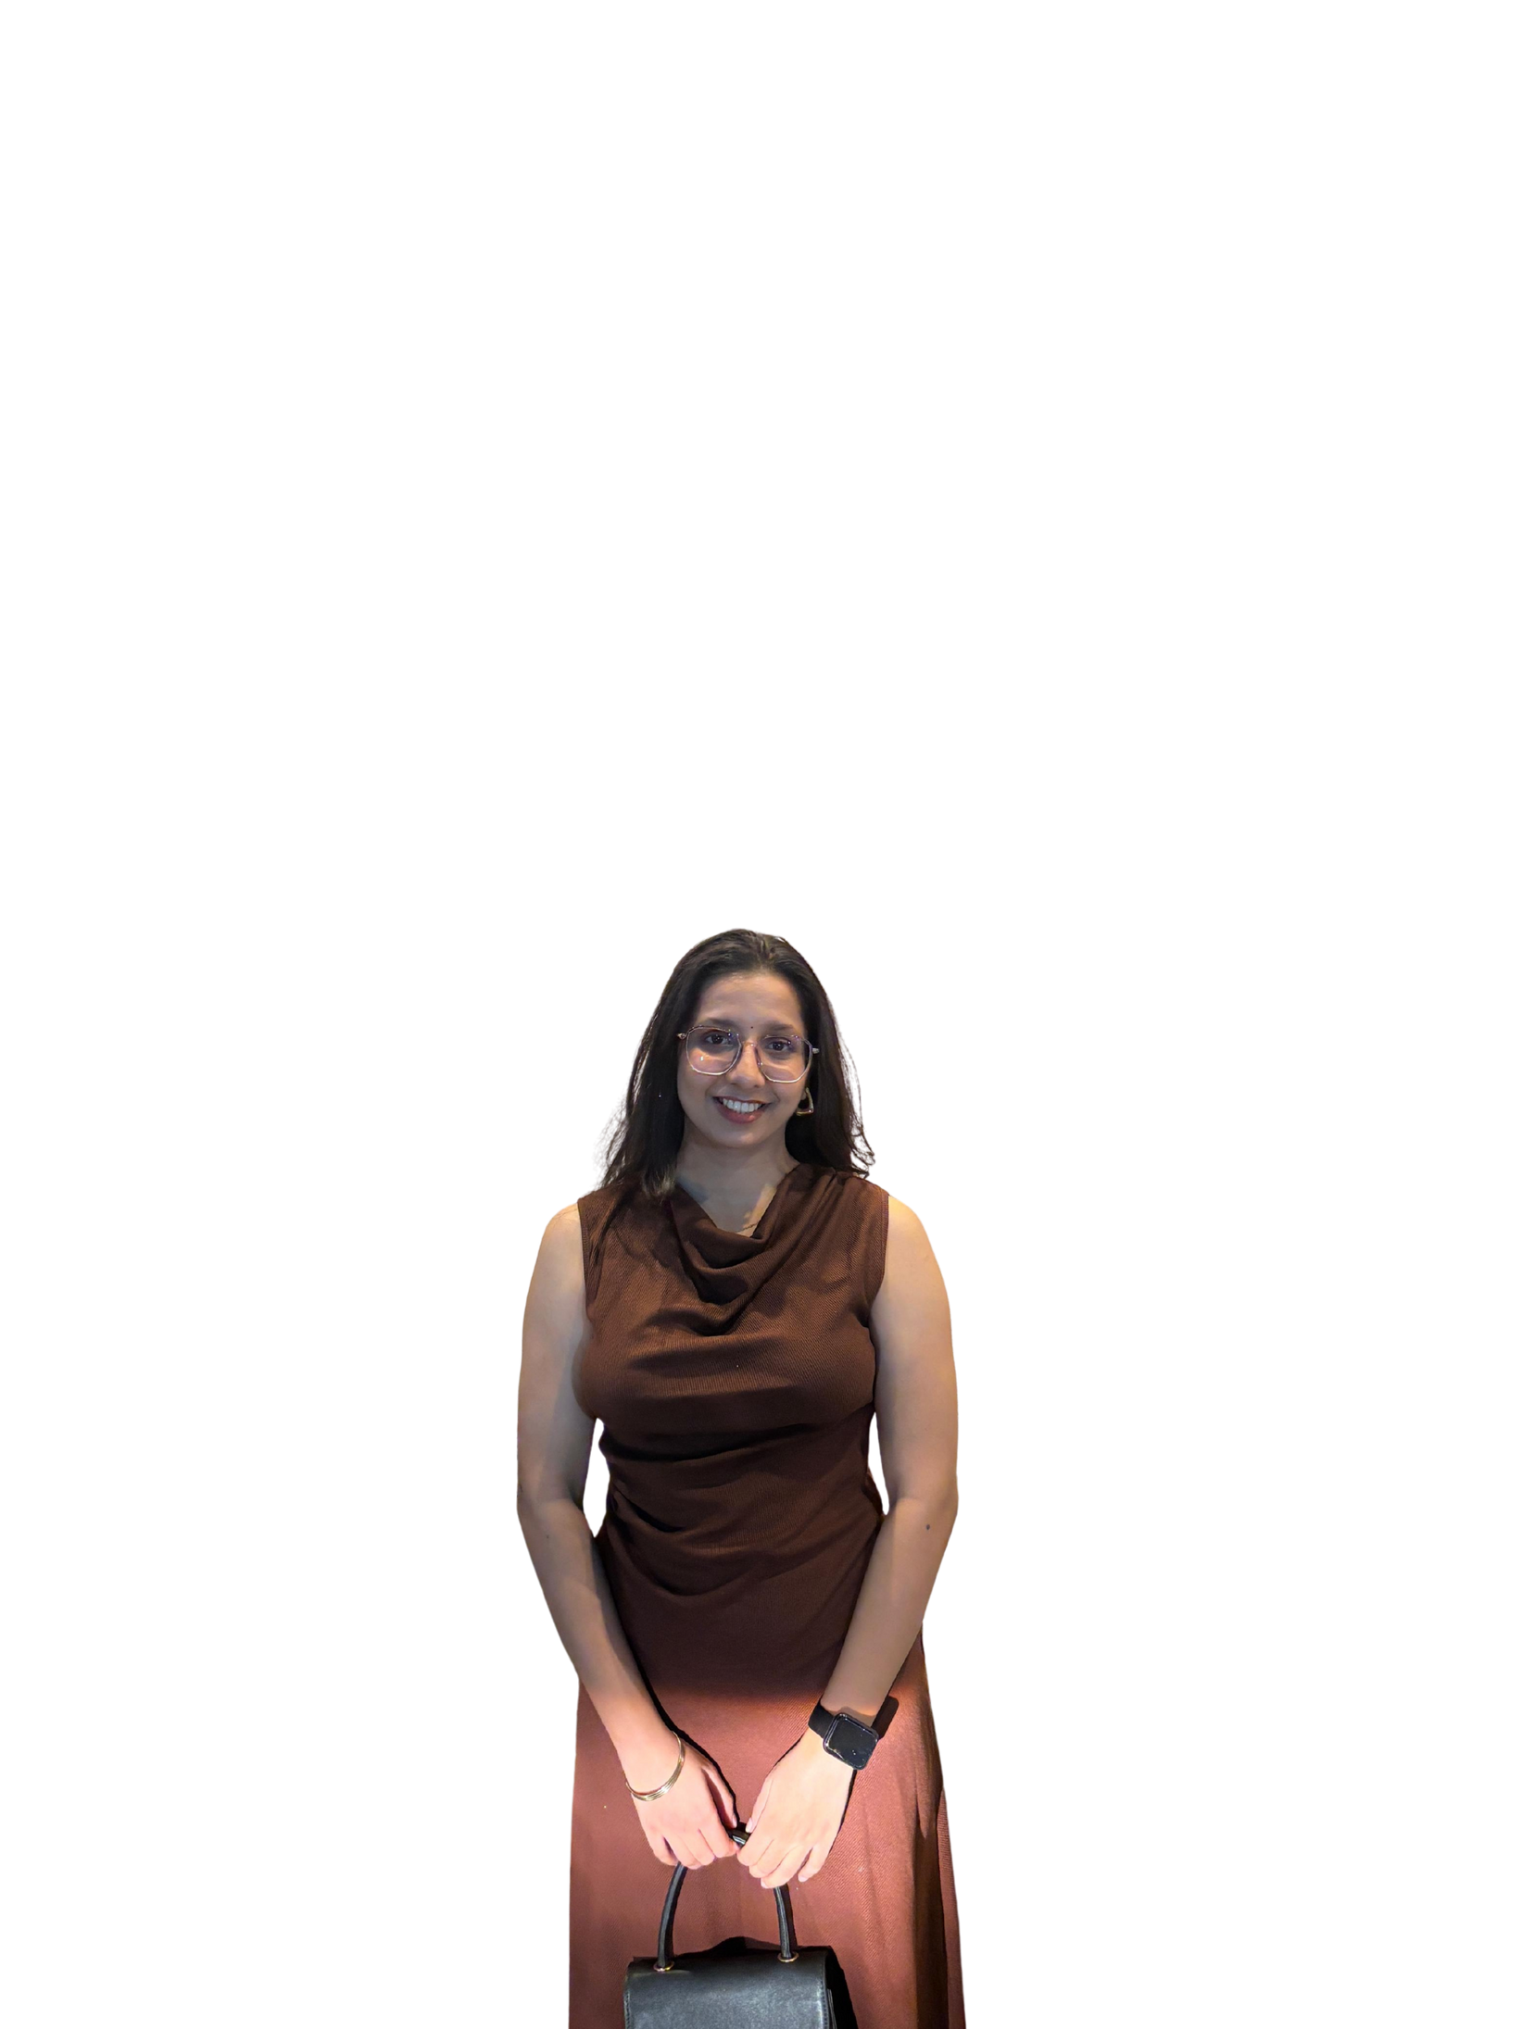
Londhe
ASHLESHA
ASHLESHA LONDHE

Slide 2

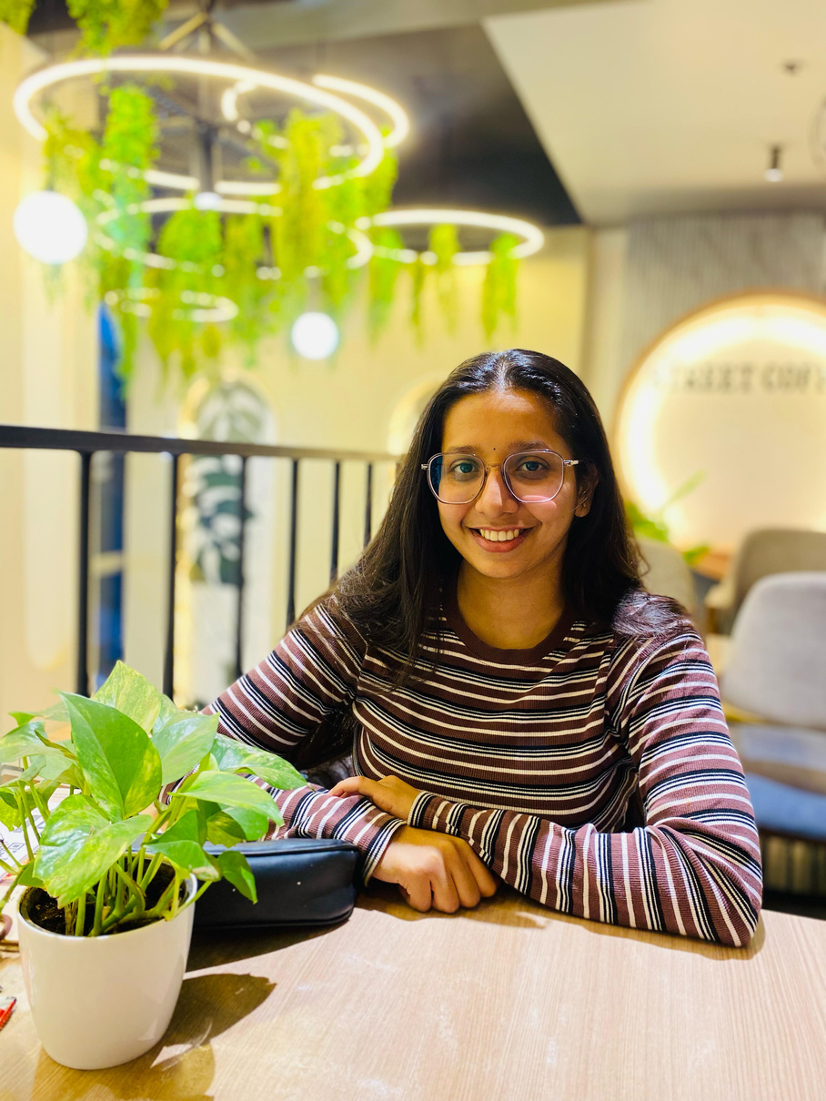
Hello! I'm a creative developer and designer based in Pune. I specialize in building responsive web applications and engaging visual content.
With a degree in Electronics & Telecommunication Engineering and hands-on experience in software development and graphic design, I blend logic with aesthetics.
Currently, I’m working as a Design and Animation Associate at Redwood Algorithms, and previously interned at Cub To King IT Solutions and RN Web Brands Solutions.
I enjoy coding, designing user interfaces, creating brand content, and telling visual stories that connect with people.
Ashlesha
INTRODUCTION

Slide 3

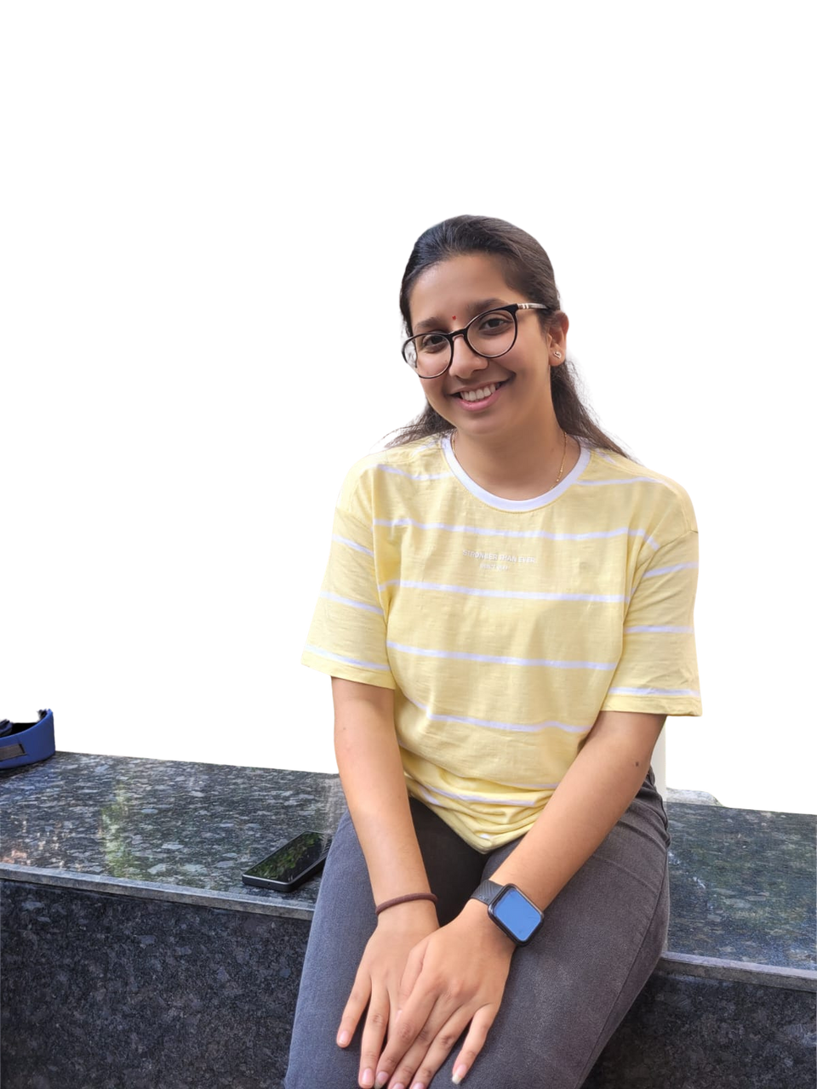

Dr. D. Y. Patil Institute of Technology, Pune
B.E. in EnTC | CGPA: 8.57/10 (2021–2024)
MIT Jr. College
12th – 66.46% (2020)
S.N.B.P. International School
10th – 78.80% (2018)
EDUCATION

Slide 4
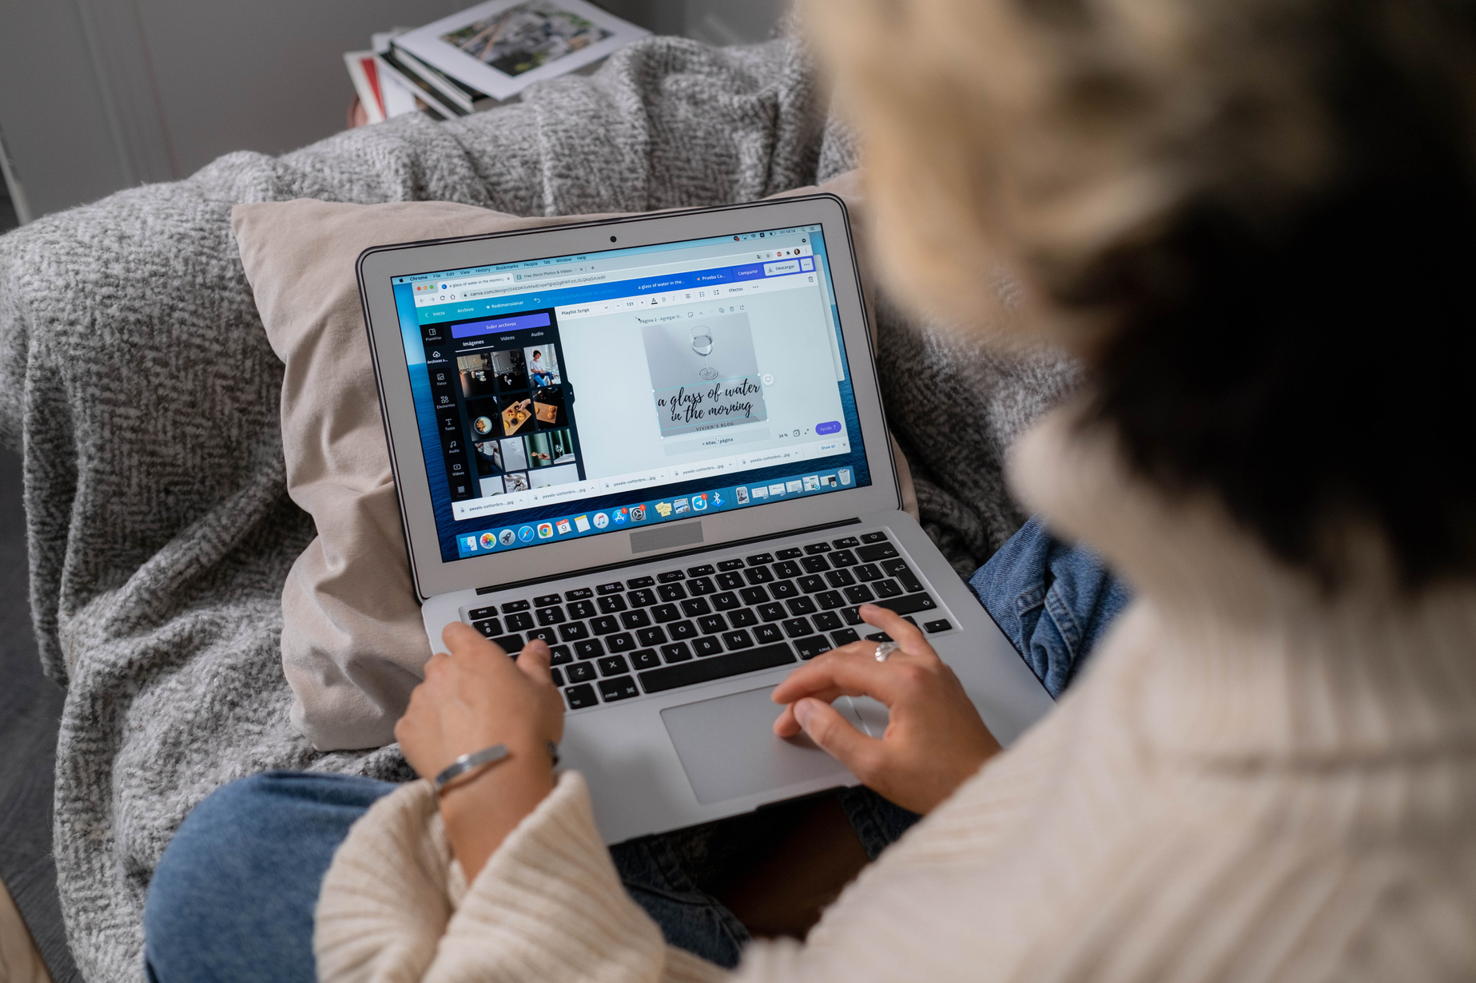
EXPERIENCE
DESIGN AND ANIMATION ASSOCIATE,
JUNIOR SOFTWARE DEVELOPER INTERN
GRAPHIC DESIGN INTERN
March 2025 – Present
Created engaging animations and graphics to boost digital branding.
Collaborated with marketing and dev teams for cohesive visual output.
June 2024 – Feb 2025
Built responsive websites including clones of Amazon, Microsoft, and Facebook.
Focused on performance, UI/UX, and team collaboration.
Jan 2023 – Mar 2023
Developed WordPress guides for non-tech users.
Worked on SEO, security, and design optimization.

Slide 5
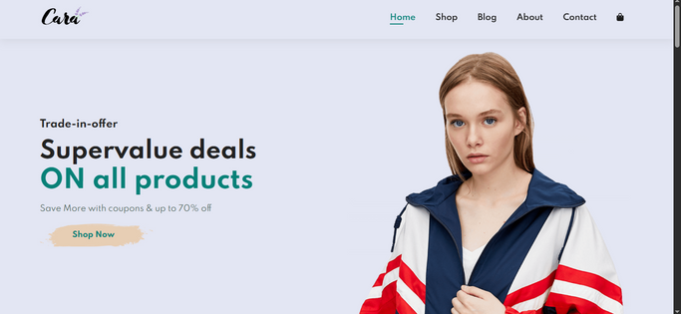
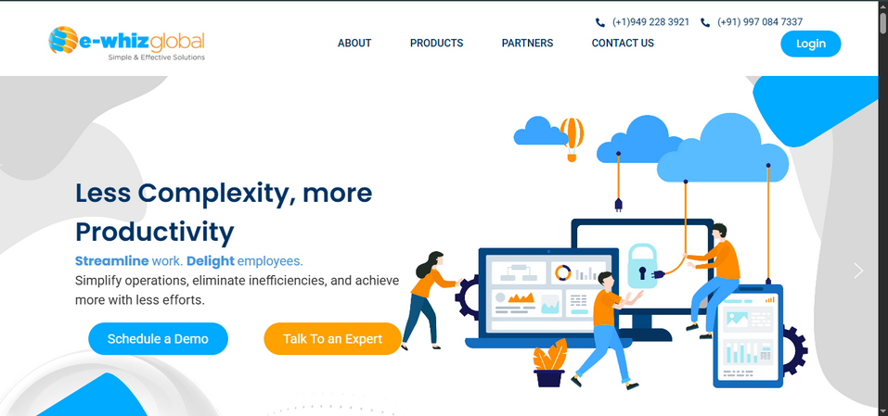
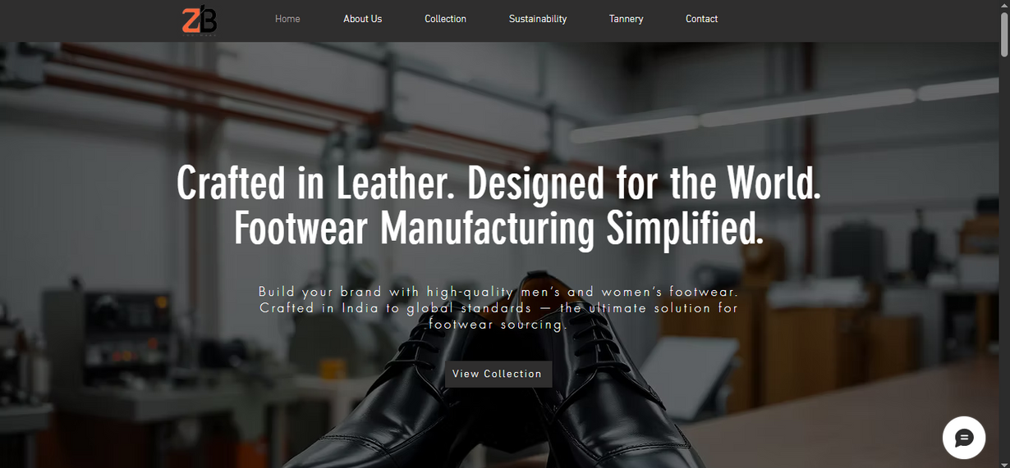
Project
PREVIOUS

Slide 6

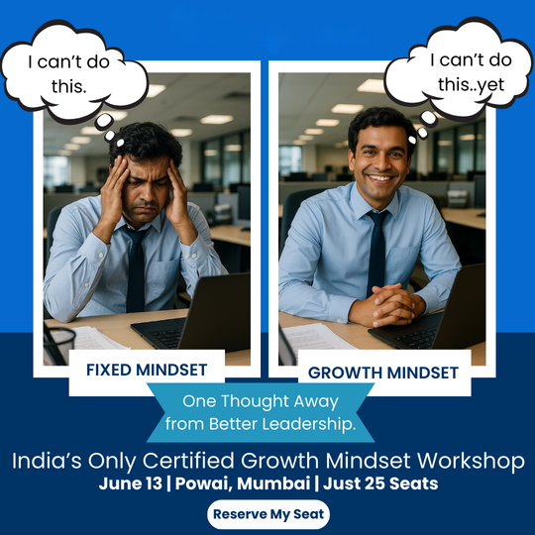
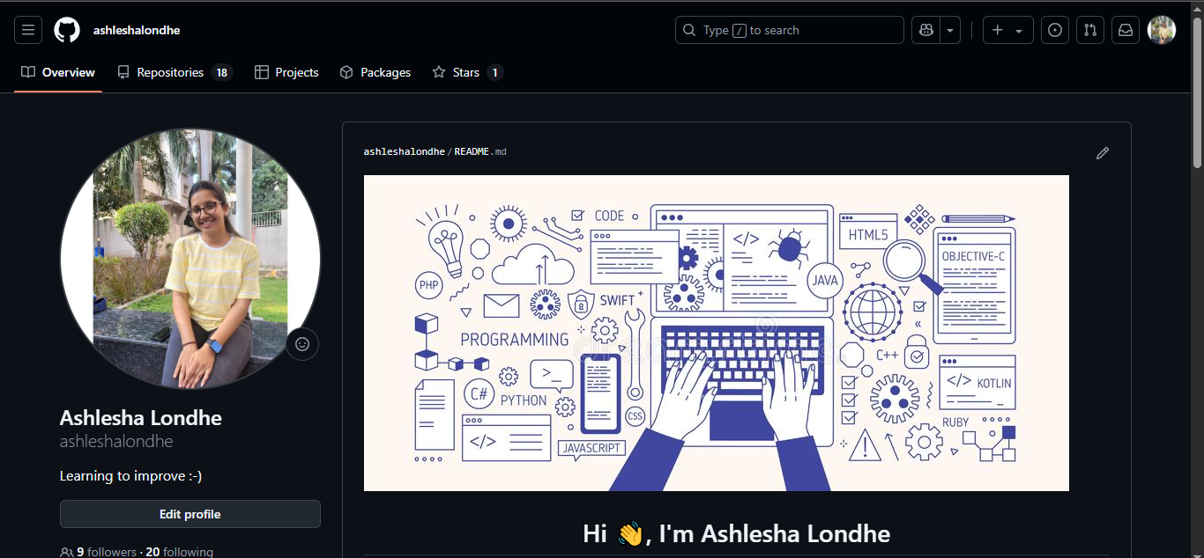
Project
PREVIOUS

Slide 7
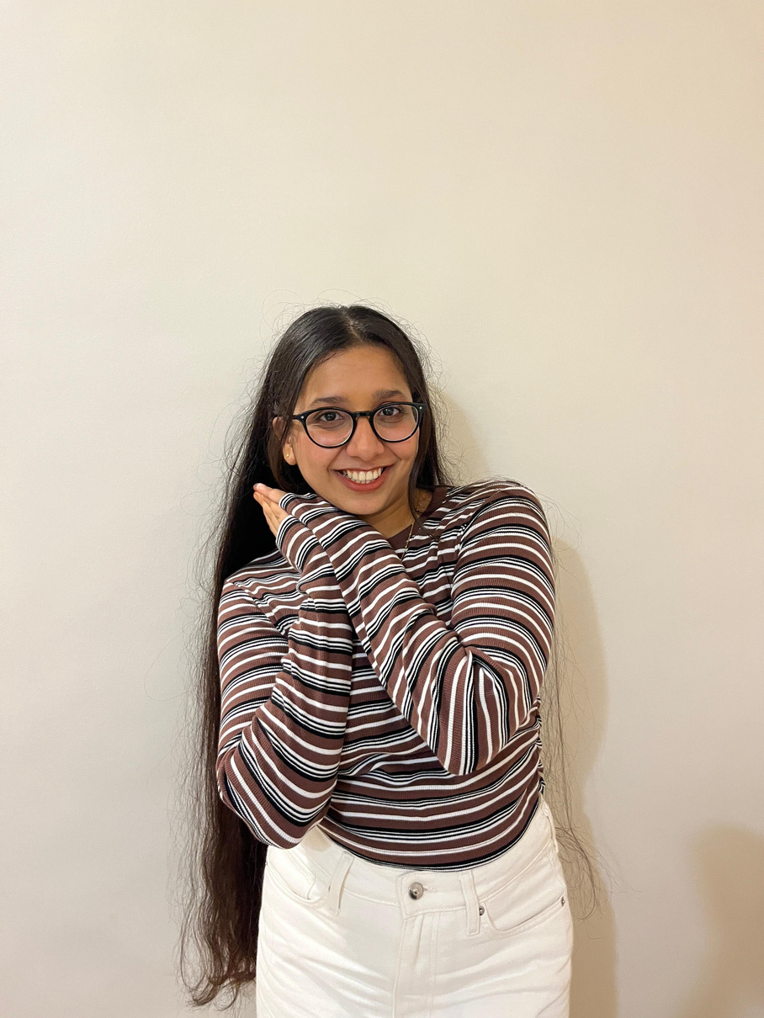
GRAPHIC DESIGN
SKILLS
THE SKILL OF CREATING VISUAL DESIGNS SUCH AS POSTERS, BROCHURES, ADVERTISEMENTS, VIDEOS, AND DIGITAL MATERIALS.
BRANDING
CREATING THE VISUAL IDENTITY OF A BRAND, INCLUDING LOGOS, COLOR SCHEMES, TYPOGRAPHY, AND OTHER GRAPHIC ELEMENTS.
WEBSITE
CREATING RESPONSIVE AND VISUALLY APPEALING WEBSITES USING HTML, CSS, JAVASCRIPT, WORDPRESS, AND WIX.

Slide 8

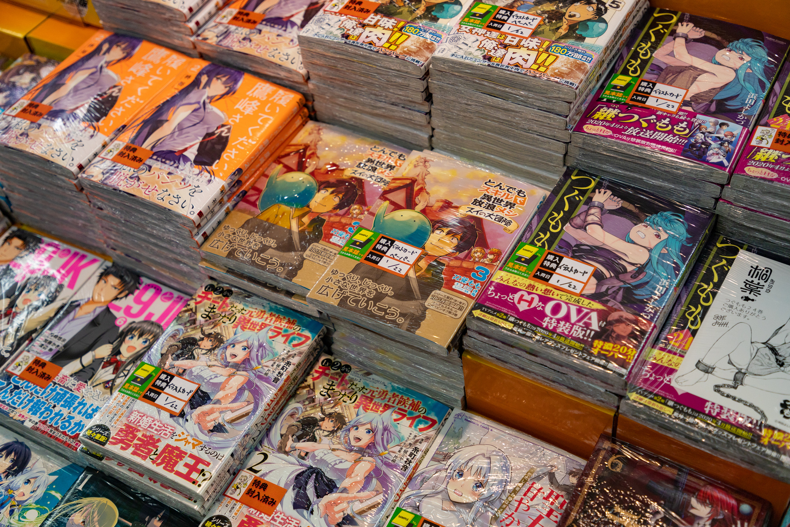

PAINTING
HOBBIES
MANGA
WATCHING KDRAMA

Slide 9
Let’s work
TOGETHER
+91 9921430001
ashleshalondhe78@gmail.com
ashleshalondhe

